Slide 1
Select Model
Gradient Boosting
Support Vector Regression
Random Forests
Generalized Linear Model (Twd/Poisson)
Extra Trees
Select Pre-processing Methods
Decrease in RMSE
Increase in RMSE
Binary encoding for neighbourhood attribute
Transform last date reviewed to no. of days since last review
Remove outliers outside IQR for numerical columns
Perform standard scaling
One-hot encoding of neighbourhood attribute
Remove listings with 0 reviews
Use sentiment rating attribute
Remove latitude and longitude outliers, 3 std dev away from mean
Remove all outliers outside of IQR
Perform robust scaling
Tune Hyperparameters
Train test split and use train set to tune hyperparameters
Use GridsearchCV to find best parameters for Random Forest Model
Predict on Test Set

Slide 2


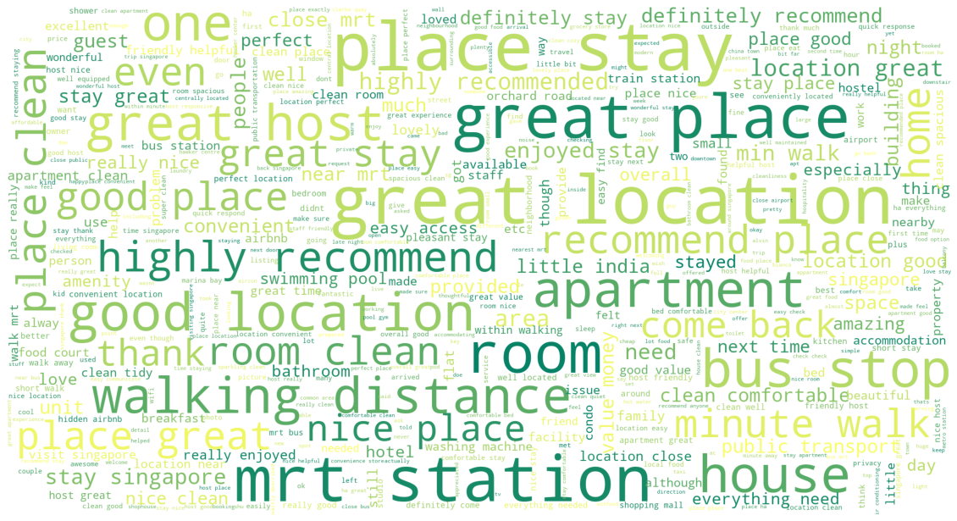
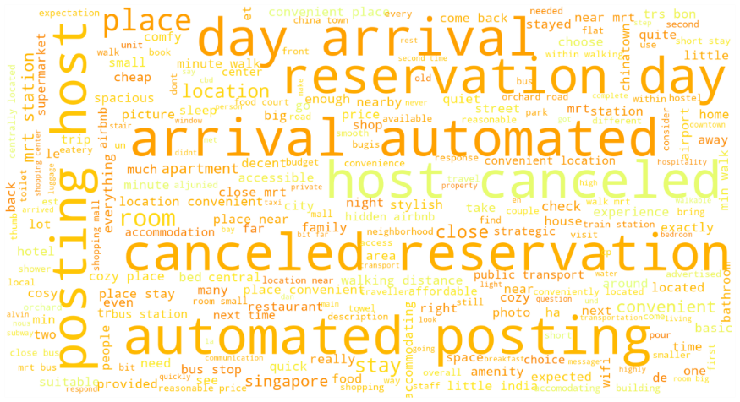
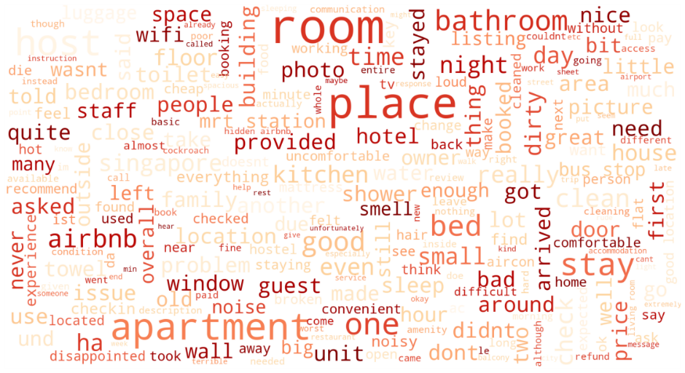
Negative
<= -0.05
Neutral
-0.05 to 0.05
Positive
>= 0.05
Place is difficult to find because of late instructions So disappointed
The host canceled this reservation 145 days before arrival This is an automated posting
Rosy is a great host and the room is lovely Big and clean with a lovely seating area to relax Bathroom is nice with a good shower
Legend:
Positive
Neutral
Negative
Data File
dataset_8.csv
Carry out
grid search for model
Evaluate search results
Use best parameters for model
Narrow range of parameters

Slide 3
Cross Validation
Validation
Train
Train
Train
Train
Train
Validation
Train
Train
Train
Train
Train
Validation
Train
Train
Train
Train
Train
Validation
Train
Train
Train
Train
Train
Validation
Train
Test

Slide 4








Data Exploration
Explore the distribution of the data for listings and reviews dataset
Find out the meaning of each attribute
Take note of missing values
Data Visualization
Explore correlation of attributes in listings dataset
Create visualizations in SandDance relating price, type of room, no. of listings and map locations
Preprocess Listings
Preprocess Reviews
Transform categorical attributes to numerical attributes using one-hot encoding
Fill missing values for reviews_per_month with 0
Transform last_review to days since last review
Drop irrelevant columns
Set price as last column
Remove outliers
Perform standard scaling
Remove reviews below 5 characters long
Remove reviews that are not alphanumeric (e.g. Korean or Chinese)
Strip whitespaces
Determine language of review by using langdetect
Remove non-English reviews
Extract sample size of 10% to test if language is accurately determined
Perform Experiments
Experiment with different regression models
Select best model with lowest RMSE
Experiment with different pre-processing methods
Select best pre-processing methods
Form baseline model
Tune hyperparameters using GridSearchCV
Sentiment Analysis
Use review sentiment
as an attribute
Use VADER library to detect polarity of reviews
Evaluate Test Results
Visualize Text Data
Compare results between baseline model and tuned RF model
Plot predicted vs actual values
Visualize text data using a wordcloud based on their sentiment (positive, neutral, negative)
Recommendations
Provide sound recommendations
based on results obtained

